Slide 1
Sustainability
Jamel Ben Chafra

Slide 2
What is sustainability?
The quatlity of being able to continue over a period of time.
The quality of causing little or no damage to the environment and, therefore, able to continue for a long time.
The quality of consuming at a pace that preserves resources for future generations.
Notes:
Don’t forget to mention that sustainability became a hot issue nowadays and is attracting more and more attention especially after COVID 19 Pandemic!

Slide 3
Renewable Energy consumption worldwide 2010 – 2020 (in exajoules)
Year | Renewable Energy Consumption
2010 | 9.70
2011 | 11.12
2012 | 12.60
2013 | 14.36
2014 | 16.03
2015 | 18.08
2016 | 20.06
2017 | 23.04
2018 | 25.83
2019 | 28.82
2020 | 31.71

Slide 4
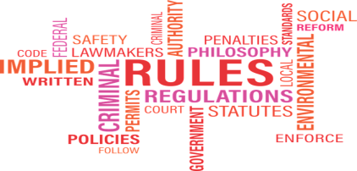
How to create a sustainable world?
Awareness
Financial Resources
Regulations
Education

Slide 5
Benefits of sustainability
Maintains environmental health
Preserves environmental biocapacity
Supports individuals’ wellbeing

Slide 6
Benefits of sustainability
Maintains environmental health
Preserves environmental biocapacity
Supports individuals’ wellbeing
Supports communities’ wellbeing

